Slide 1
Information Storage & Retrieval - CSCI 642 Final Project Topic Modeling With Few Shot Learning Mind Hack Zombies Kameswara Pullabhotla (Z1891893) Anuj Shah (Z1905195)

Slide 2
Project
GOAL:
The current research helps us in analyzing what topics are discussed over the past 20 years in the IR Bulletins and provides us with the trend of the topics discussed. Furthermore, our few short learning model will provide us with a model that helps us find the topic related to a section/paragraph.

Slide 3
Project
Task 1:
Evaluating topic models and extracting topics (Top 20) from the corpus using Topic Modeling.
Tag the topics to the documents.
Visualize the trend across years.
Task 2:
Creating a Few Shot/Zero Shot learning models to predict relevant topics for the inputted sentence/paragraph.

Slide 4
Dataset
IRS Online Bulletins
Internal Revenue Bulletin (IRB) announces official rulings and procedures of the IRS (Internal Revenue Service) and for publishing Treasury Decisions, Tax Conventions, and other items of general interest.
Size(appx 3 GB) :
Includes bulletins published weekly for past 20 years.
Format :
Unstructured PDF files
Link :
https://www.irs.gov/irb

Slide 5
Topic Modeling – What & Why?
Most of the data in the world is unstructured. It is a very expensive task for humans to organize such data.
“Transformer Models” helped us in translating human meaning to computers in finding the semantic meaning of words. But they lag much behind.
Machines that can understand human language are helpful in organizing these unstructured documents. In Machine Learning this act of automatic clustering of data into particular topics is know as “Topic Modeling”.

Slide 6
Dynamic BerTopic Modeling - Methods
Embedding Models
Sentence Transformers
Flair
TF-IDF
Dimensionality Reduction
UMAP
Topics Representation & Clustering
c-TF-IDF
HDSCAN

Slide 7
Process Flow
Documents
Sentence Transformers
UMAP
Document Vectors (384-10K)
C-TF-IDF
Visualization
Topic Filtering

Slide 8
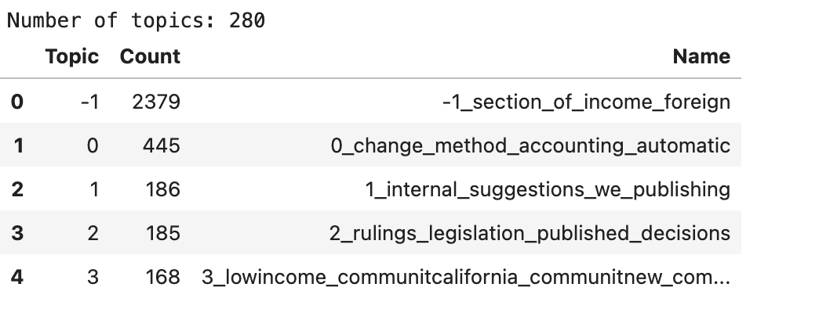
Analysis
Processed 5 years data i.e., 2018 – 2022
Sentence Transformers

Slide 9
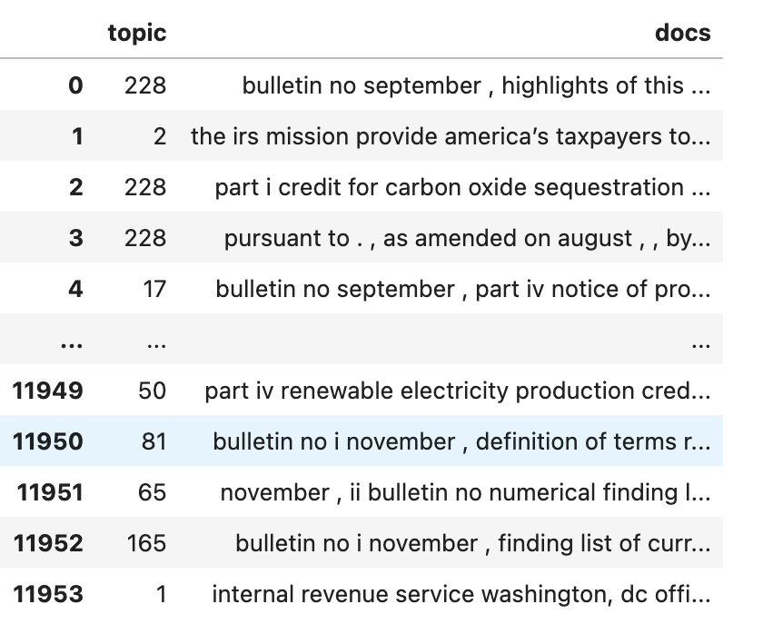
Continued..

Slide 10
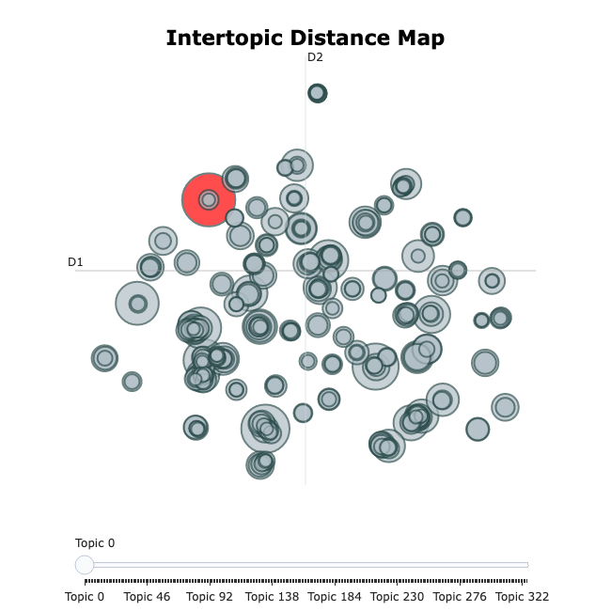
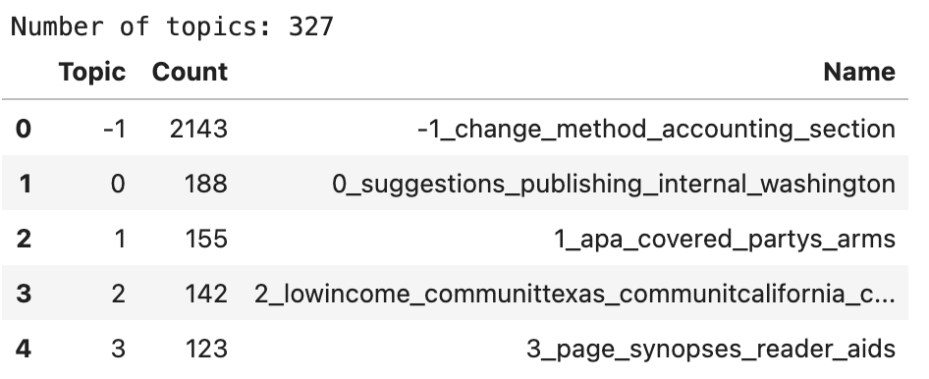
TF-IDF Vectorizer

Slide 11
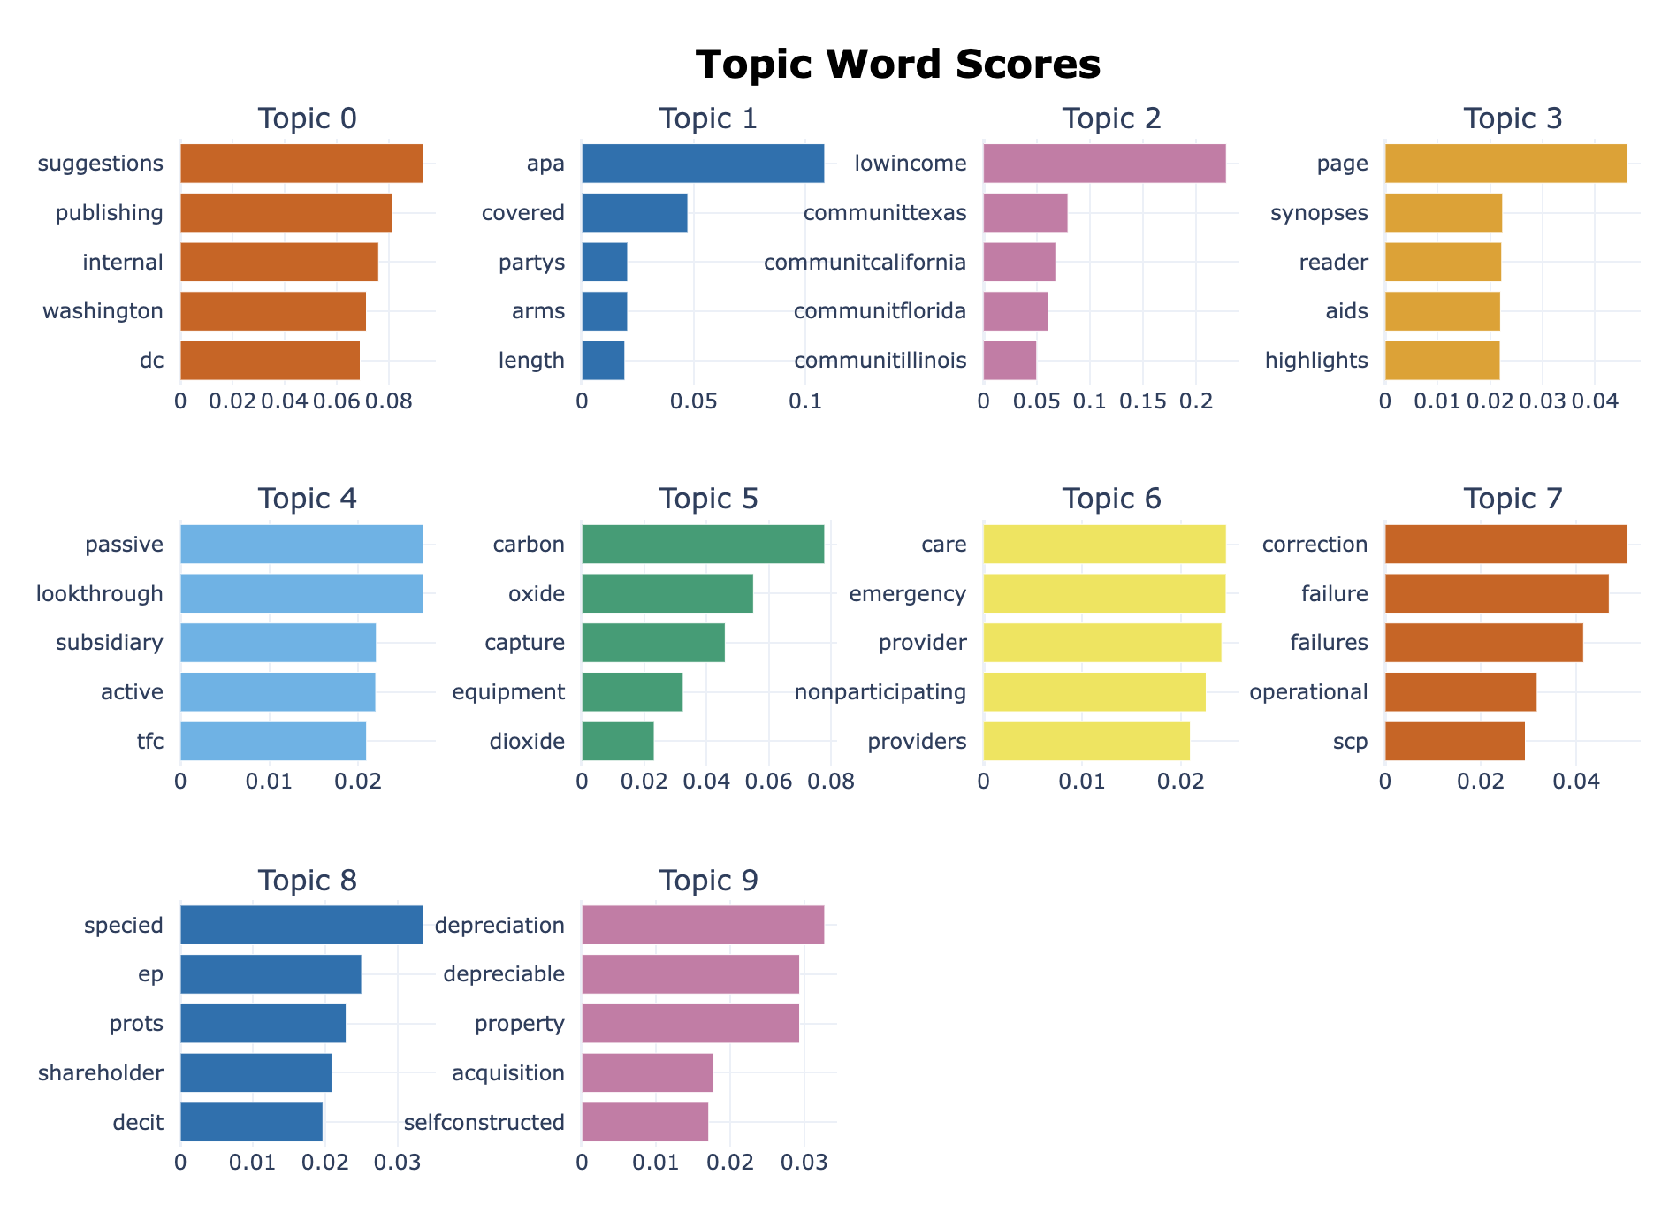
Continued..

Slide 12
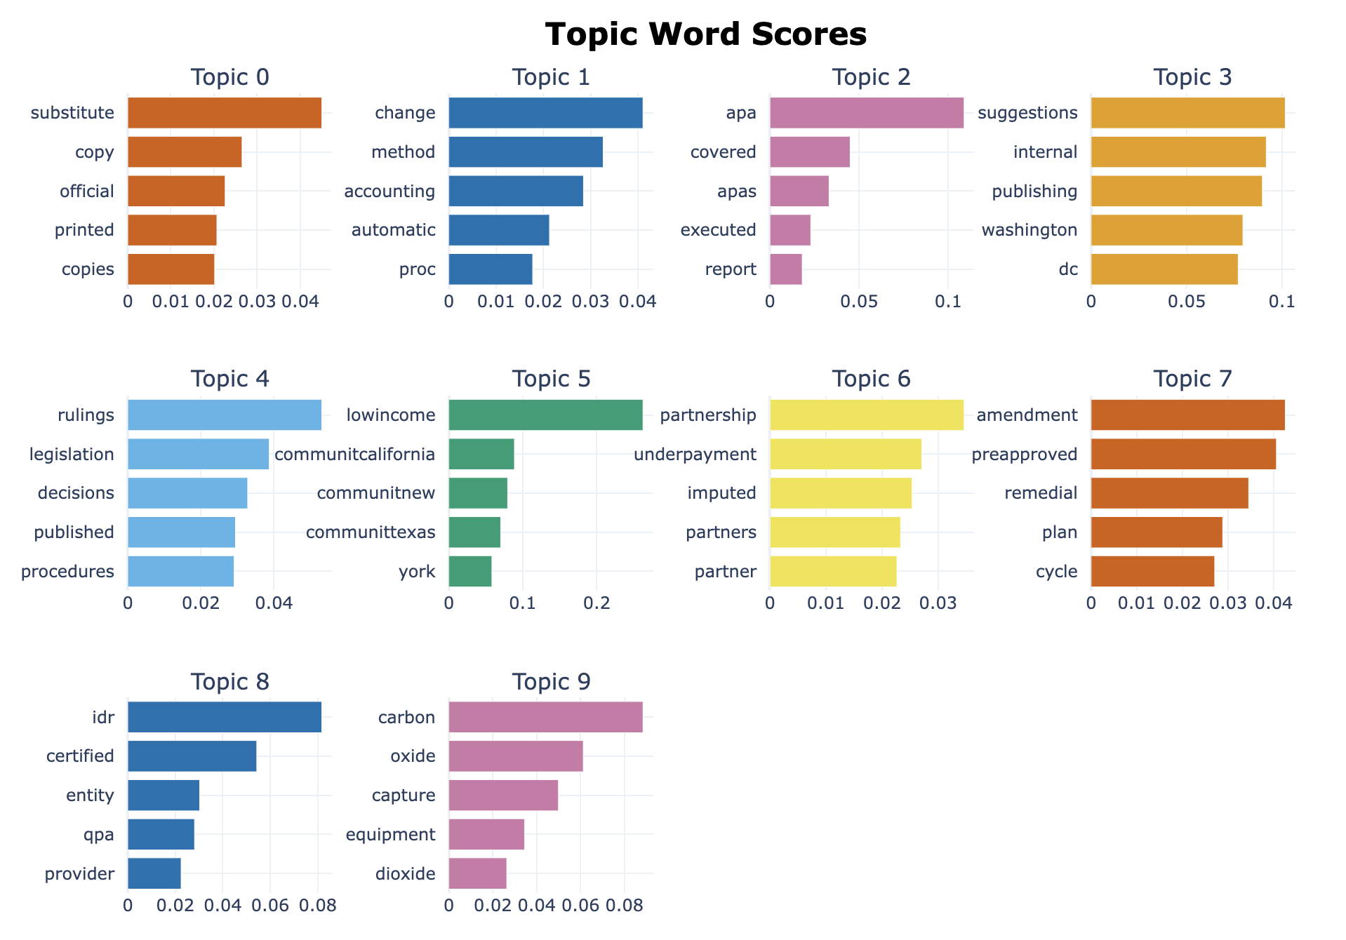
UMAP

Slide 13
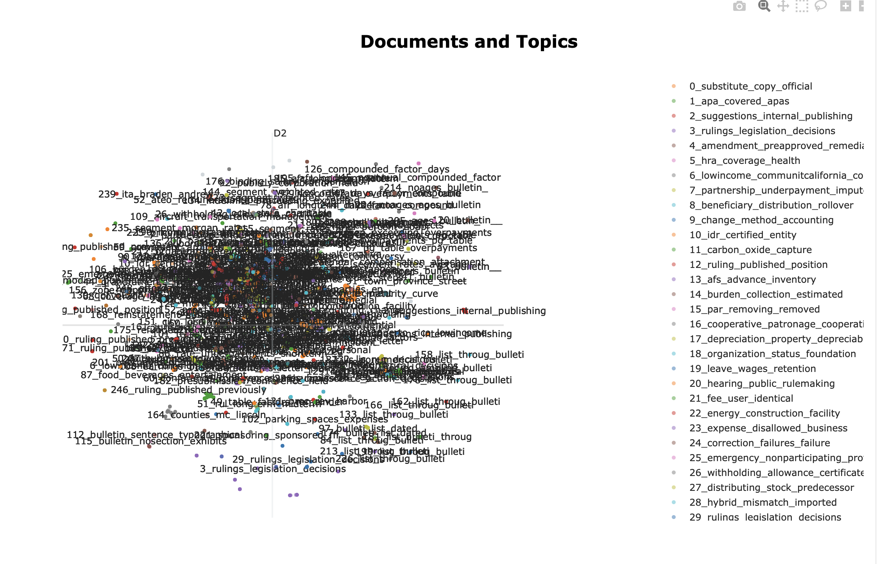
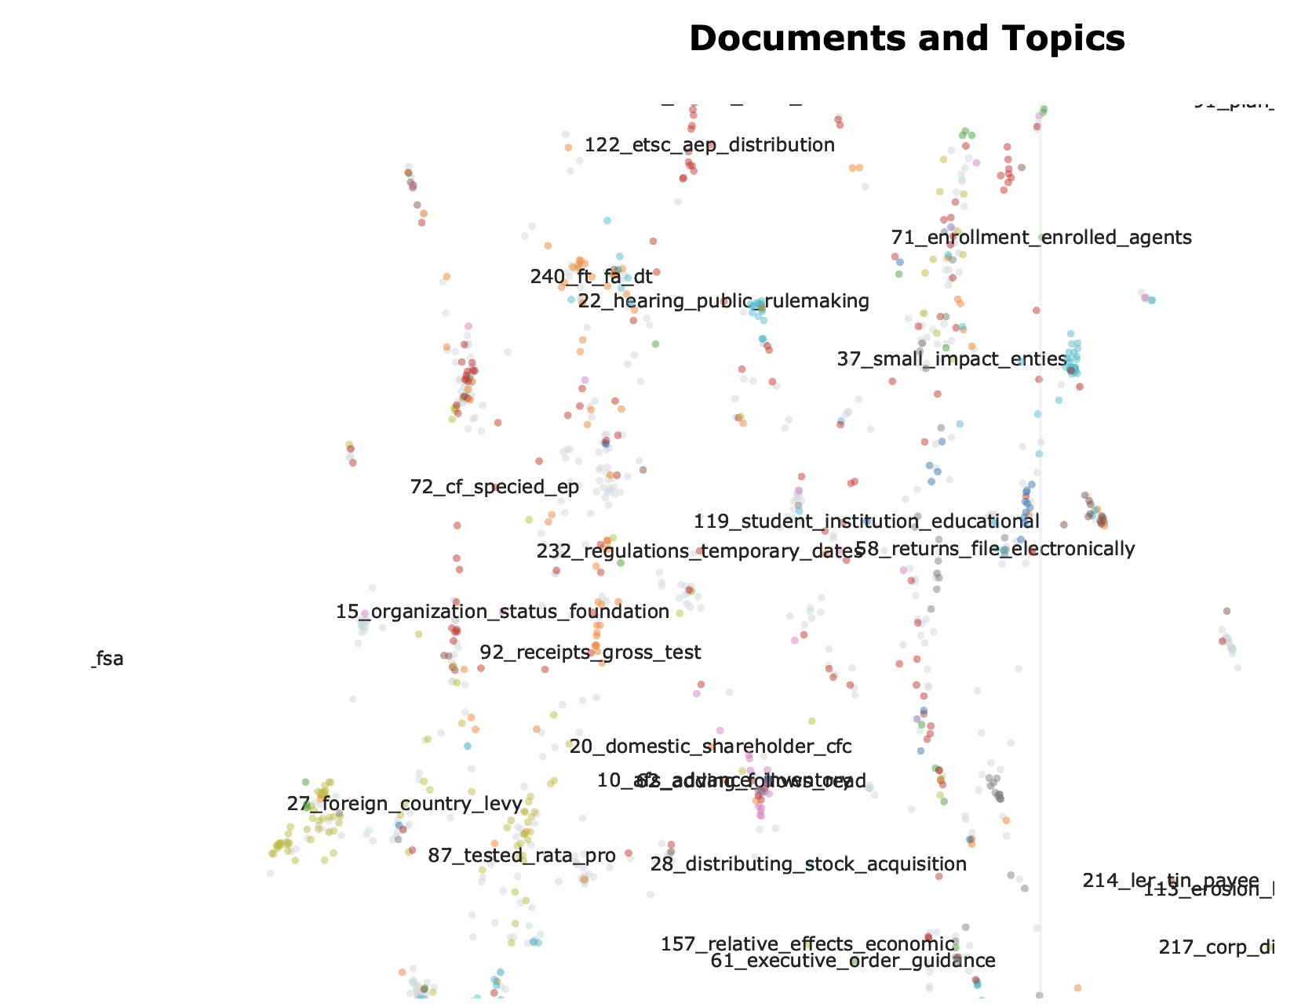
Continued..

Slide 14
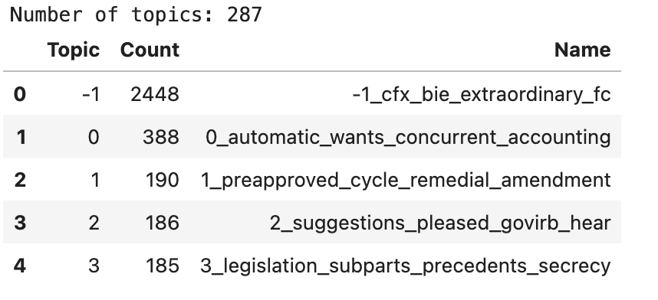
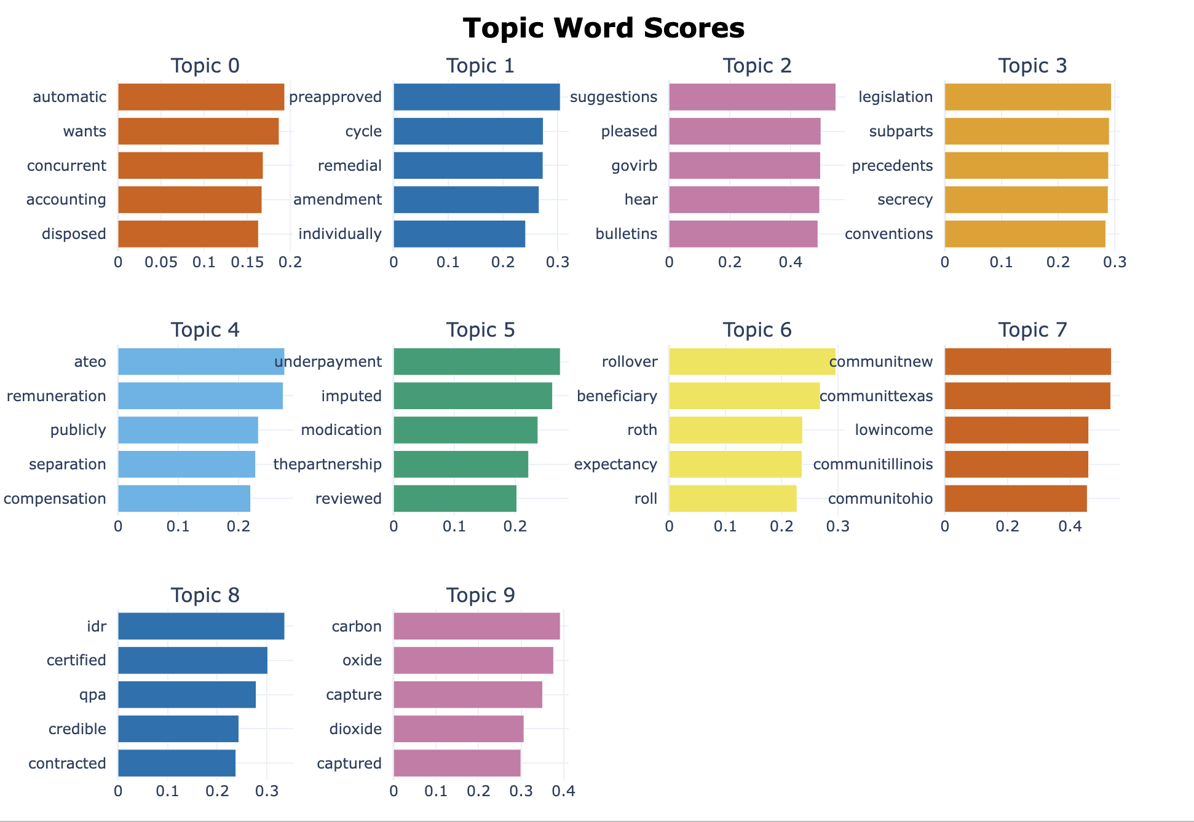
c-TF-IDF

Slide 15
Text Classification Methods
Rule-based systems
Machine Learning based systems:
Naive Bayes
Support Vector machines
Deep Learning
N-way-K-Shot Learning:
Zero-Shot Learning
One-Shot Learning
Few-Shot Learning
Hybrid systems

Slide 16
Zero-Shot Learning
Classify unseen classes without any training examples.
Implementation:
Learning a joint embedding space between seen and unseen labels.
Usage:
Package: Flair
Types of transformers:
Name Entity Recognition
Text Tagging
Text Embedding
Classification:
TARSClassifier

Slide 17
Zero-Shot Example
Seen classes
Attributes
Description
Sad: Any Context That Means Showing Sorrow
I’m glad you liked the gift.
Good
Model
I’m doing well.
Good
Unseen classes
Sad
She was crying.
I don’t feel like talking.
Bad
Training
Inference

Slide 18
Pros & Cons Of Zero-Shot Learning
PROS
Handles unseen classes, where supervised learning fails.
Helps construct Bilingual dictionaries for languages used very less.
CONS
Evaluating model on unseen samples is computationally intensive.
Reliance on learning a joint embedding space.

Slide 19
Few-Shot Learning
Classify new data, given a few samples.
Implementation
Learning to learn by itself.
Usage
Package: SetFitClassifier
Package: Pytorch
Repo: Latent Text Embedding with SBERT

Slide 20
Few-Shot Example
Seen classes
Attributes
I’m glad you liked the gift.
Happy
Unseen classes
Model
I’m doing well.
Happy
She was crying.
Sad
I don’t feel like talking.
Sad
Training
Inference

Slide 21
Pros & Cons Of Few-Shot Learning
PROS
Requires less data.
Knowledge can be transferred.
Less time for training the model compared to traditional models
CONS
Model will certainly achieve less accuracy.
There is no standard procedure to train the model.

Slide 22
Questions?

Slide 23
Thank You

